Slide 1
Types of Government Around the World

Slide 2
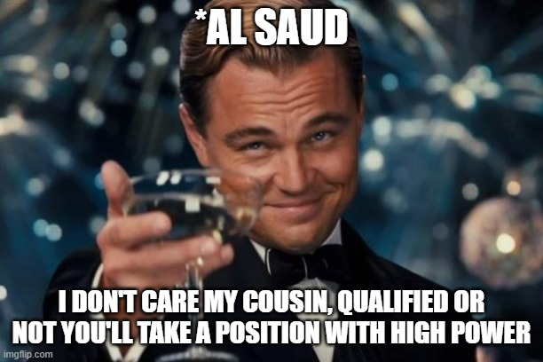
Authoritarian

Slide 3

Monoarchy

Slide 4
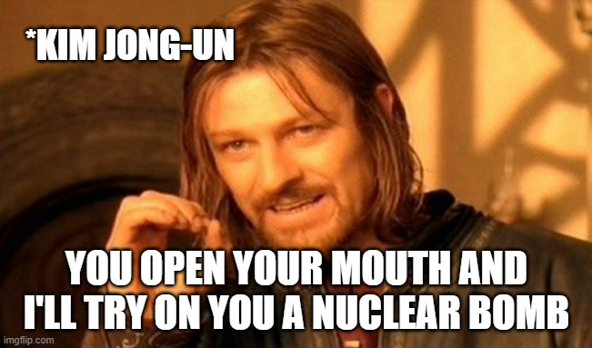
Totalitarian

Slide 5
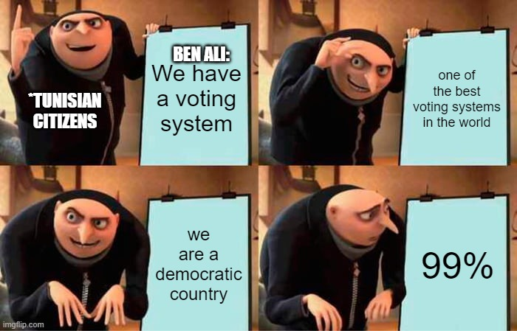
Democracy

Slide 6
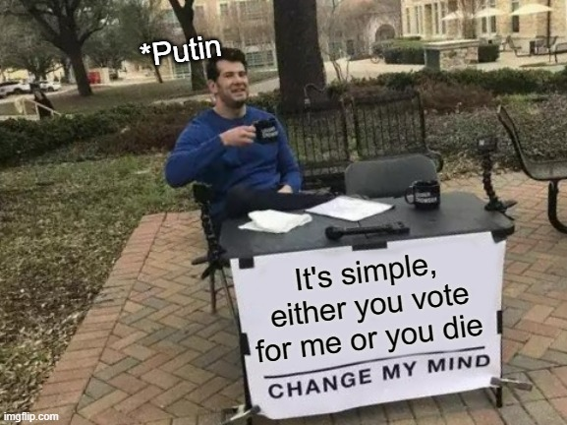

Slide 7
Thank you

